Slide 1
Chapter 2
Systems Model

Slide 2
Introduction
Ways to view the organization of a distributed system
logical organization of the collection of software components (Software architecture)
tell us how the various software components are to be organized and how they should interact.
actual physical realization
requires that we instantiate and place software components on real machines.
The final instantiation of software architecture is also referred to as system architecture.

Slide 3
Architectural Styles
Logical organization (Software architecture)
formulated in terms of
Components
the way that components are connected to each other
the data exchanged between components
how these elements are jointly configured into a system
connectors
mechanism that mediates communication, coordination, or cooperation among components
It can be formed by the facilities for (remote) procedure calls, message passing, or streaming data.

Slide 4
Using components and connectors, we can come to various configurations which in turn have been classified in to architectural styles.
Layered architecture
Pure, mixed and layered organization with upcalls
Object-based architecture
Data-centered architecture
Event-based architecture
Pure Layered architecture
components are organized in a layered fashion where a component at layer L_{i} is allowed to call components at the underlying layer L_{i-1}

Slide 5
This model has been widely adopted by the networking community (i.e. network layer).
control generally flows from layer to layer: requests go down the hierarchy whereas the results flow upward

Slide 6
Object-based architecture
each object corresponds to a component and these components are connected through a (remote) procedure call mechanism
matches the client-server system architecture.

Slide 7
Data-centered architecture
Evolve the idea that processes communicate through a common repository like shared distributed file system
For example, web-based distributed systems are largely data-centric
Event-based architecture
processes essentially communicate through the propagation of events
event propagation has been associated with what are known as publish/subscribe systems

Slide 8
The basic idea is that processes publish events after which the middleware ensures that only those processes that subscribed to those events will receive them

Slide 9
Event-based architectures can be combined with data-centered architectures, this is known as shared data spaces

Slide 10
System Architecture
Deals with
how processes are organized in a system;
where do we place software components
Deciding their interaction
Centralized architectures
Decentralized architectures
Hybrid architectures

Slide 11
Centralized Architecture
is a client-server model
A server is a process implementing a specific service, for example, a file system service or a database service, web service, mail service etc
A client is a process that requests a service from a server by sending a request and subsequently waiting for the server's reply
client-server interaction is also known as request-reply behavior

Slide 12
Communication between a client and a server can be implemented by:
Connectionless Protocol called UDP (User Datagram Protocol)
Connection Oriented Protocol called TCP (Transmission Protocol)

Slide 13
Connectionless Protocol
It is fairly reliable. It does not require acknowledgement. (standard letter through PO)
Preferable with applications such as streaming audio, video and voice over IP (VoIP).
When a client requests a service,
it identifies the services it want, packages the message along with the necessary input data and send it to the server
The server
Always waits for an incoming request, process it, package the results in a reply message and finally send it to the client.
It is efficient. As long as messages do not get lost or corrupted, it works fine.

Slide 14
Drawbacks
When no reply message comes in, the client can possibly resend the request. Because the client can not detect whether the original request message was lost, or that transmission of the reply failed
If the reply was lost, then resending a request may result in performing the operation twice.(The operation my be harmful or harmless)
Ex. Transferring some amount of money from your account twice
When an operation can be repeated multiple times without harm, it is said to be idempotent

Slide 15
Connection Oriented Protocol
Many client-server systems use a reliable connection oriented protocol (eg. EMS)
Connection must be established before communication and terminated at the end.
The client send request and the server replay to the requests using the same connection.
Acknowledgement is required and lost messages must be retransmitted
FTP and HTTP are examples of applications that use TCP
Drawback: establishing and terminating connection is costly

Slide 16
Application Layer
In client-server model there is no clear distinction between a client and a server. For example, a server for a distributed database may act as a client when it forwards requests to different file servers responsible for implementing the database tables.
client-server applications support user to access databases. The applications consists of three levels:
The user-interface level:
The processing level
The data level

Slide 17
User interface level
contains all that is necessary to directly interface with the user.
Clients typically implement the user-interface level.
consists of the programs that allow end users to interact with applications.
The Processing level contains applications.
The data level manages the actual data that is being acted on.
For example, in an Internet search engine

Slide 18
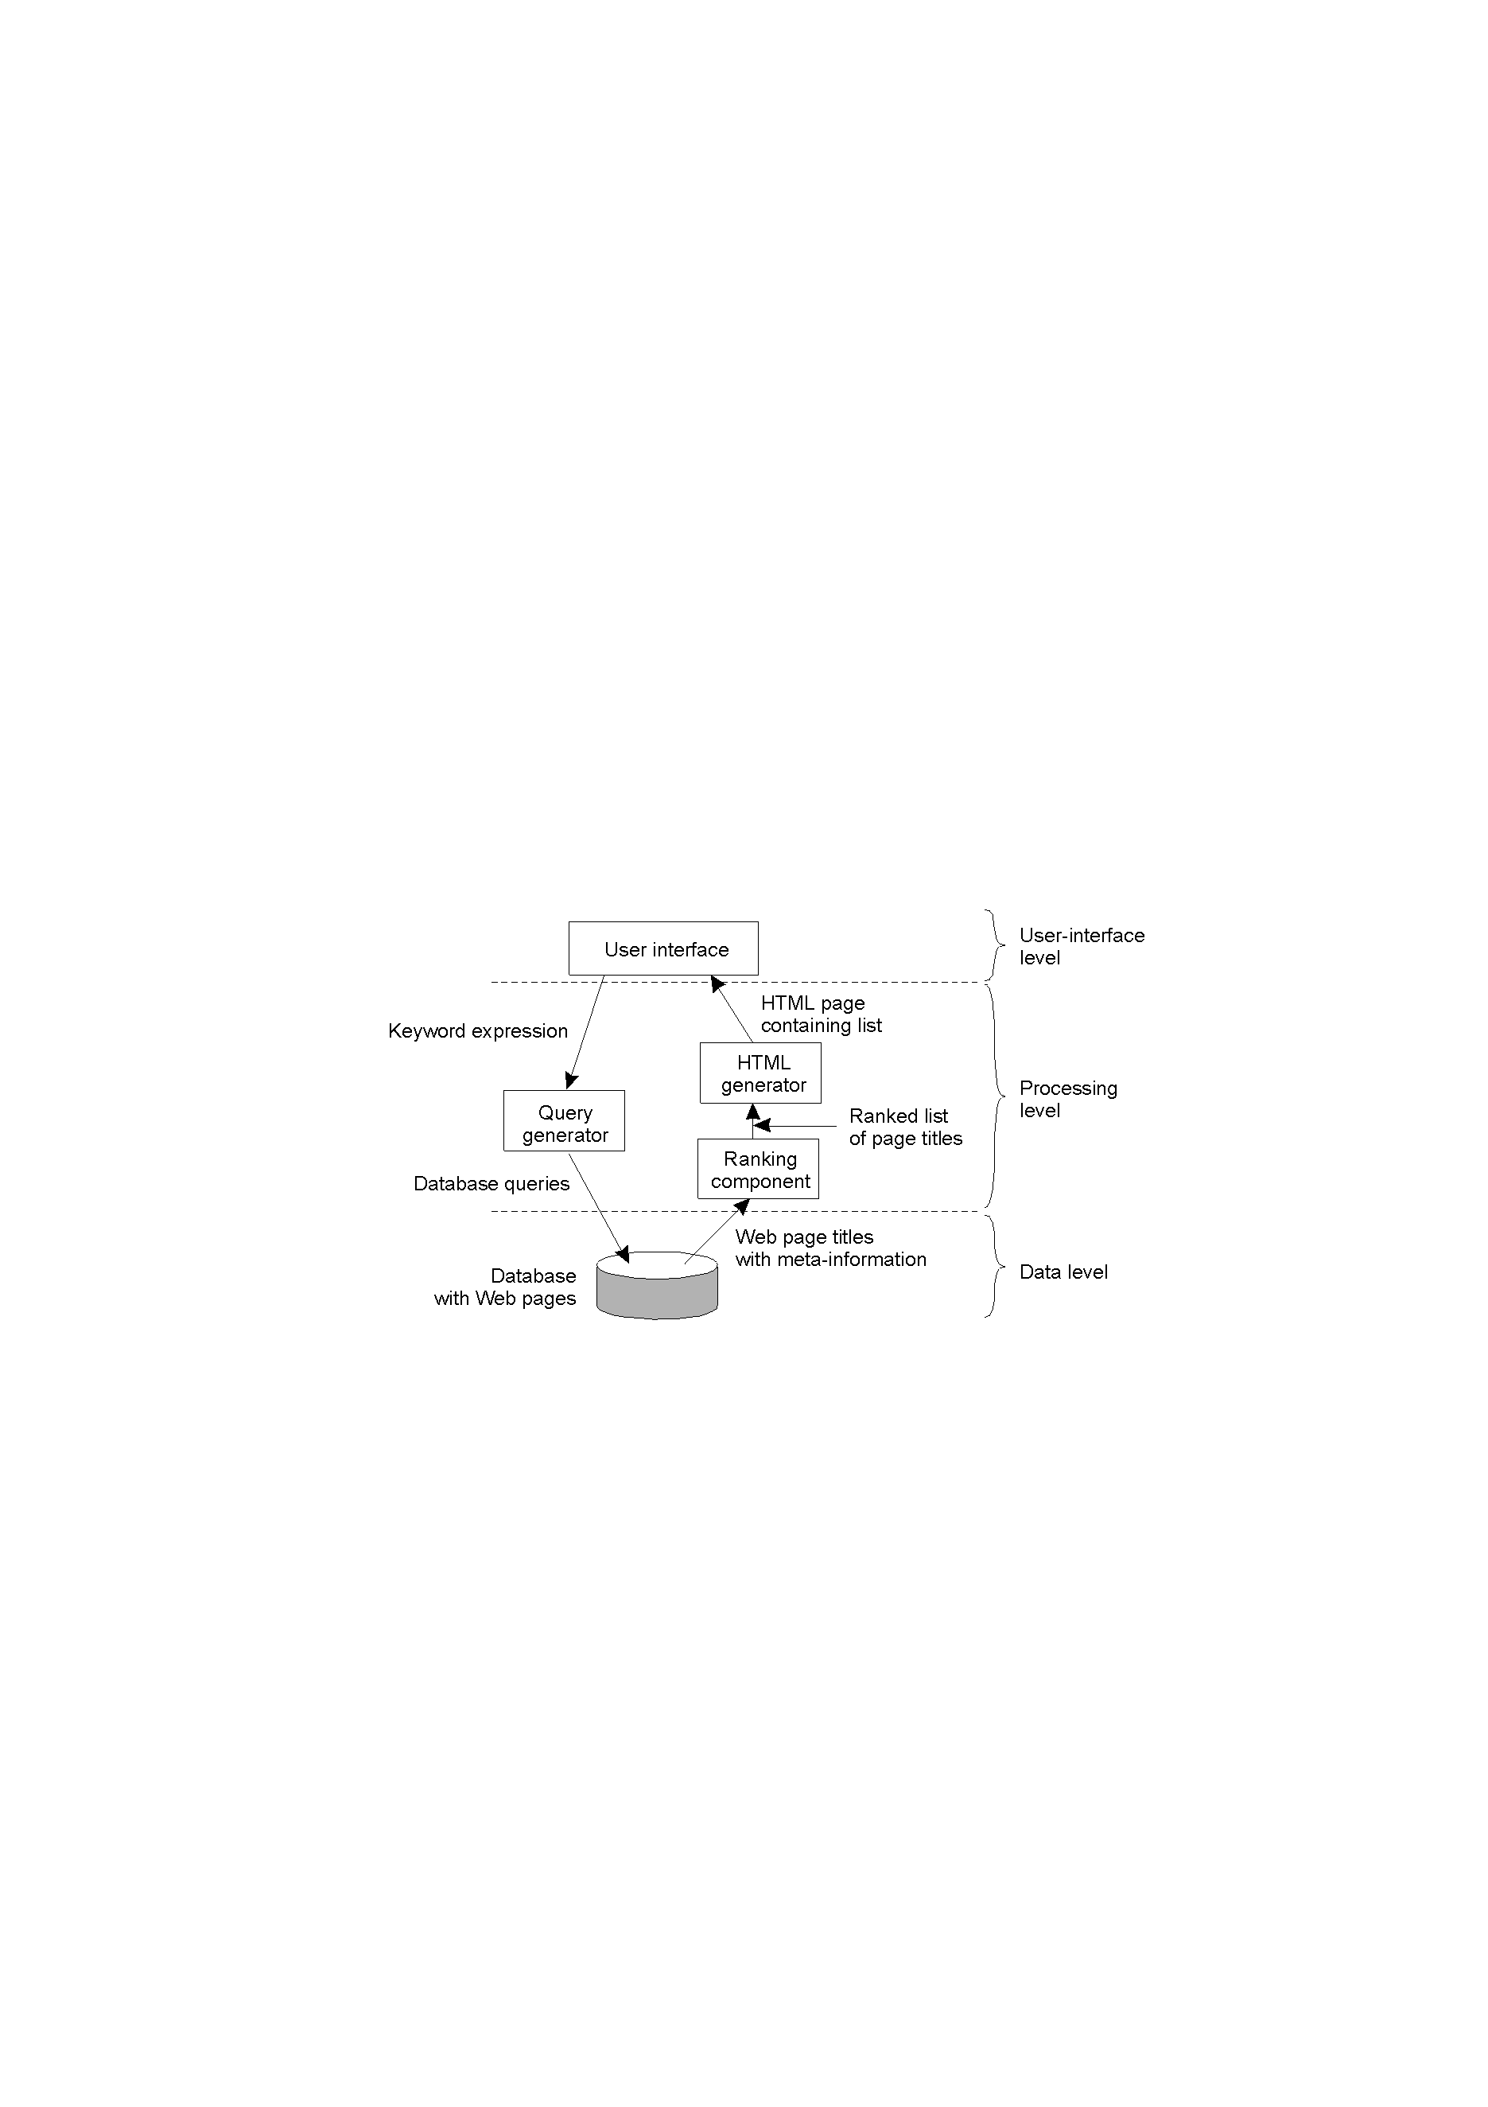

Slide 19
Multitier Architectures
The distinction into three logical levels suggests possibilities for physically distributing a client-server application across several machines.
The simplest organization is to have only two machines
Client Machine: implement only user interface level(dump terminal)
Server Machine: implement process & data level
The other approach is to distribute the programs in the application layers across different machines

Slide 20
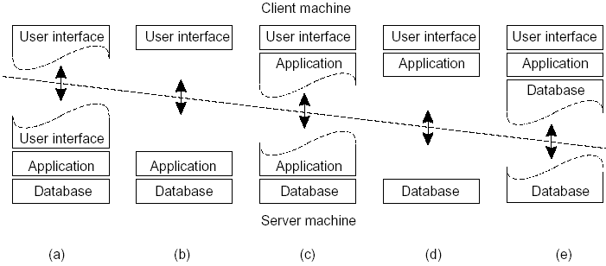
Physically Two-tiered architecture: alternative client-server organizations
In many client-server environments, the organizations shown in Fig. (d) and Fig. (e) are particularly popular
Essentially, most of the application is running on the client machine, but all operations on files or database entries go to the server.
For example, banking applications

Slide 21
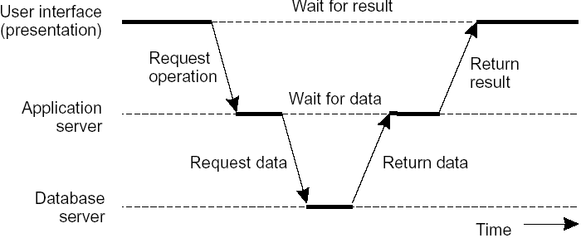
Server may sometimes need to act as a client
Three tiered architecture: an example of a server acting as a client
In this architecture, programs that form part of the processing level reside on a separate server, but may additionally be partly distributed across the client and server machines.

Slide 22
Decentralized Architecture
Multi-tiered client-server architectures are also known as vertical distribution. It is achieved by placing logically different components on different machines.
In modern architecture, the distribution is horizontal i.e. a client or server may be physically split up into logically equivalent parts, but each part is operating on its own share of the complete data set, thus balancing the load. Example: peer-to-peer system
Much of the interaction between processes is symmetric: each process can act both as a client and a server at the same time

Slide 23
Peer-to-peer architectures evolve an overlay network organization.
In a structured peer-to-peer architecture, the overlay network is constructed using a deterministic procedure.
the most-used procedure is to organize the processes through a distributed hash table (DHT).
data items are assigned a random key from a large identifier space
nodes in the system are also assigned a random number from the same identifier space.
A request for a data item is accomplished by routing it to the responsible node.

Slide 24
Unstructured peer-to-peer systems, rely on randomized algorithms for constructing an overlay network.
each node maintains a list of neighbors
data items are assumed to be randomly placed on nodes
when a node needs to locate a specific data item, the only thing it can effectively do is flood the network with a search query.

Slide 25
Hybrid Architecture
Here client-server solutions are combined with decentralized architectures.
In this architecture the distributed system is formed by edge-server systems
These systems are deployed on the Internet where servers are placed "at the edge" of the network. This edge is formed by the boundary between enterprise networks and the actual Internet
When end users at home connect to the Internet through their ISP, the ISP can be considered as residing at the edge of the Internet

Slide 26
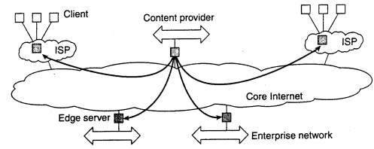
End users or clients in general, connect to the Internet by means of an edge server.
For a specific organization, one edge server acts as an origin server from which all content originates. That server can use other edge servers for replicating Web pages.

Slide 27
Another instance of hybrid structure is that of collaborative distributed systems
The main issue in many of these systems is to first get started, for which often a traditional client-server scheme is deployed.
Once a node has joined the system, it can use a fully decentralized scheme for collaboration.
Ex.
BitTorrent file-sharing system (a p2p file downloading system)
Globule content distribution system

Slide 28
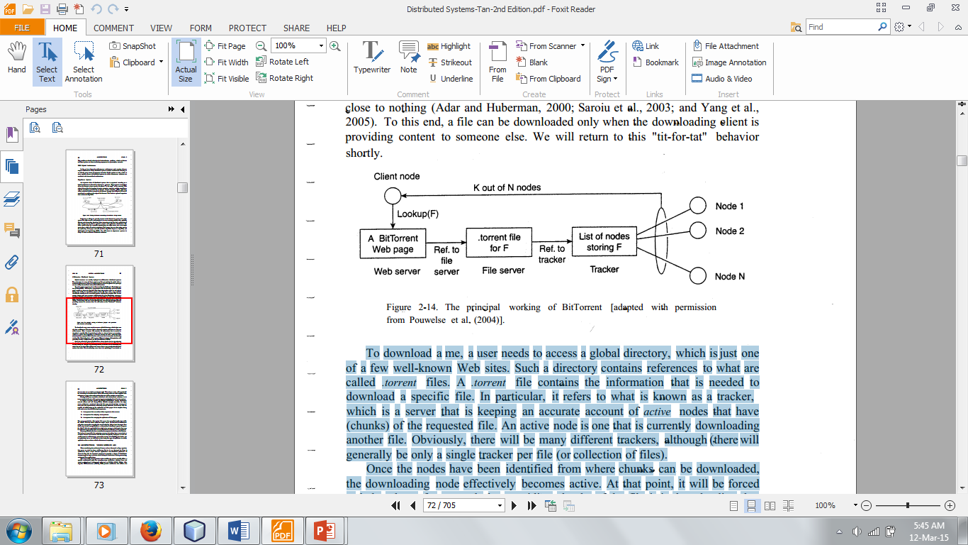
To download a file
a user needs to access a global directory(web site)
Such a directory contains references to .torrent files
A .torrent file contains the information to be downloaded
it refers to a tracker: is a server that keeps an accurate account of active nodes that have (chunks) of the requested file.
there will generally be only a single tracker per file or collection of files

Slide 29
An active node is one that is currently downloading another file.
Once the nodes have been identified from where chunks can be downloaded, the downloading node effectively becomes active. At that point, it will be forced to help others.
This enforcement comes from a very simple rule: if node P notices that node Q is downloading more than it is uploading, P can decide to decrease the rate at which it sends data to Q.
Super-peer network is also a hybrid network.

